Slide 1
System Design Document
The used book transaction platform
-- Team Name

Slide 2
Contents
Page 3 → Page 19 CRC Cards
Page 20 System Interaction and Environment
Page 21 System Architecture
Page 22 → Page 24 System Decomposition

Slide 3
CRC Cards
-- Name: App
-- Responsibilities:
-- Register a new user/admin, recording the basic account info in the database
-- Create a new post/mail/profile and record its info in the database
-- Construct the server
-- Collaborators: None

Slide 4
CRC Cards
-- Name: UINavigator
-- Responsibilities:
-- Define the functions/responsibilities of all front-end buttons&forms interacting with the back-end database
-- Collaborators: None

Slide 5
CRC Cards
-- Name: User
-- Responsibilities:
-- Knows its username and password
-- Can update/delete the user’s basic info
-- Can create/delete/update its posts and edit its profile
-- Can send/receive email
-- Collaborators: UserDAOImple, Post, Profile, Mail, App

Slide 6
CRC Cards
-- Name: Post
-- Responsibilities:
-- Knows who makes the post
-- Knows the basic info(id, date&time, content) of the post
-- Can update/delete this post’s info
-- Collaborators: PostDAOImple

Slide 7
CRC Cards
-- Name: Mail
-- Responsibilities:
-- Knows the sender and receiver
-- Knows the basic info(id, date&time, content) of the email
-- Can update/delete this mail’s info
-- Collaborators: MailDAOImple

Slide 8
CRC Cards
-- Name: Profile
-- Responsibilities:
-- Knows who owns this profile
-- Knows its basic info(contact info, preferences)
-- Can update/delete this profile
-- Collaborators: ProfileDAOImple

Slide 9
CRC Cards
-- Name: Administrator
-- Responsibilities:
-- Knows its username and password
-- Can update/delete any user’s basic info
-- Can create/delete/update any posts and edit any profile
-- Can send/receive email
-- Can delete/update any email
-- Collaborators: UserDAOImple, Post, Profile, Mail, App

Slide 10
CRC Cards
-- Name: UserDAO <Interface>
-- Responsibilities:
-- Provide the abstraction of operations on the user accounts’ info in the database
-- Collaborators: None

Slide 11
CRC Cards
-- Name: PostDAO <Interface>
-- Responsibilities:
-- Provide the abstraction of operations on the posts’ info in the database
-- Collaborators: None

Slide 12
CRC Cards
-- Name: MailDAO <Interface>
-- Responsibilities:
-- Provide the abstraction of operations on the emails’ info in the database
-- Collaborators: None

Slide 13
CRC Cards
-- Name: CommentDAO <Interface>
-- Responsibilities:
-- Provide the abstraction of operations on the comments’ info in the database
-- Collaborators: None

Slide 14
CRC Cards
-- Name: ProfileDAO <Interface>
-- Responsibilities:
-- Provide the abstraction of operations on the profiles’ info in the database
-- Collaborators: None

Slide 15
CRC Cards
-- Name: UserDAOImple
-- Responsibilities:
-- store a newly created user’s information in the database
-- update/delete a user’s information in the database
-- Collaborators: UserDAO (implements)

Slide 16
CRC Cards
-- Name: PostDAOImple
-- Responsibilities:
-- store a newly created post’s information in the database
-- update/delete a post’s information in the database
-- Collaborators: PostDAO (implements)

Slide 17
CRC Cards
-- Name: MailDAOImple
-- Responsibilities:
-- store a newly created email’s information in the database
-- update/delete a email’s information in the database
-- Collaborators: MailDAO (implements)

Slide 18
CRC Cards
-- Name: CommentDAOImple
-- Responsibilities:
-- store a newly created comment’s information in the database
-- update/delete a comment’s information in the database
-- Collaborators: CommentDAO (implements)

Slide 19
CRC Cards
-- Name: ProfileDAOImple
-- Responsibilities:
-- store a newly created profile’s information in the database
-- update/delete a profile’s information in the database
-- Collaborators: CommentDAO (implements)

Slide 20
System Interaction and Environment
The technologies will be using are:
Server: Node.js, Express framework
Database: Nedb
Front-end: HTML5, CSS, plaint JavaScript
The users will be able to use our application through a PC on a modernly widely used browser(e.g. Safari, Chrome)

Slide 21
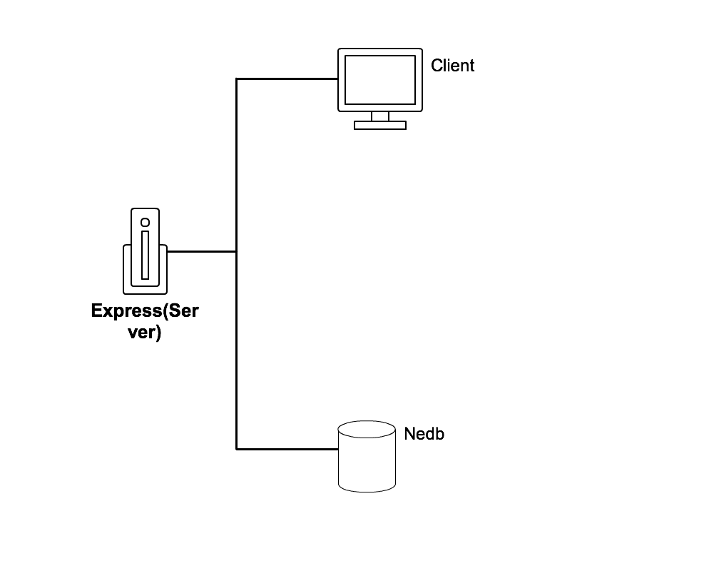
System Architecture
Data transmission:
Between Client and Server: AJAX requests and json responses
Between Server and database: json

Slide 22
System Decomposition – design pattern
The design pattern is MVC
View: The views are described in html text
Model: The model contains the database, API and all object definitions(user, post etc.)
Controller: The controller provides a layer setting between views and the model. Specifically, the controller defines how information are derived from front-end html(buttons, forms etc.), how information are retrieved from the database and what calculations are done between the client-server interaction to make successful communication

Slide 23
System Decomposition – job of classes
The class UINavigator is created for specifying the responsibilities of all front-end views(buttons, forms etc.) by giving definition of the events will be triggered once the user input are passed through views.
The classes User, Post, Comment, Administrator and Profile are served as a cache place for better organizing information derived from front-end user input or retrieved from the database.
The classes App and all interface implementations are responsible for directly accessing database.

Slide 24
System Decomposition – strategy for errors
There are 4 types of errors that users might encounter when using our app:
-- Unexpected user input: If the user provide meaningless or bad information through views, we will prompt a message with hint to the user, asking for valid input.
-- Connection error between the client and the server: In this case, the AJAX requests are not properly received by the server. Then we will prompt a message and ask the user to try again while check to see if there is some bug in the code or if the problem comes from somewhere else.
-- Internal server error: This happens when there are some errors occurred when the server is processing information, which are probably bugs in the routers’ event handler functions or any functions for data calculation. Then we will prompt a message to tell the user that they have to wait until we solve the server’s bug
-- Database error: There might also be some errors exist in the Nedb database(although not so possible). However, if there are, we will try to contact Nedb’s developers to inform them of the bugs or directly contribute to fix the bugs in Nedb(since it is open-source on Github). In this case, we still have to prompt a message to tell the user that they have to wait until everything is fixed.

